Slide 1
Smart Home System Design Using IoT With Integrated Voice Commands
By
SK.Shamshad (192211213)
C. Janani(192211958)

Slide 2

Introduction to Smart Home Devices
Smart home devices are transforming the way we live. These connected devices offer convenience, comfort, and enhanced control over your home environment.

Slide 3

Voice Command Integration
Imagine controlling your lights, music, and thermostat with just your voice! Voice assistants like Amazon Alexa and Google Assistant have made voice control seamless and convenient.
1
Effortless Control
2
Hands-Free Convenience
Control your devices with simple commands.
Free your hands for other tasks.
3
Enhanced Accessibility
Voice control is beneficial for those with mobility challenges.

Slide 4
Mobile App Interface
Smart home apps provide a centralized hub for managing your devices from anywhere. These apps offer customization, scheduling, and monitoring capabilities.
Remote Control
Customization and Scheduling
Monitoring and Notifications
Manage your home from anywhere with an internet connection.
Receive alerts about activity, temperature changes, or security events.
Set schedules, create routines, and personalize settings.

Slide 5
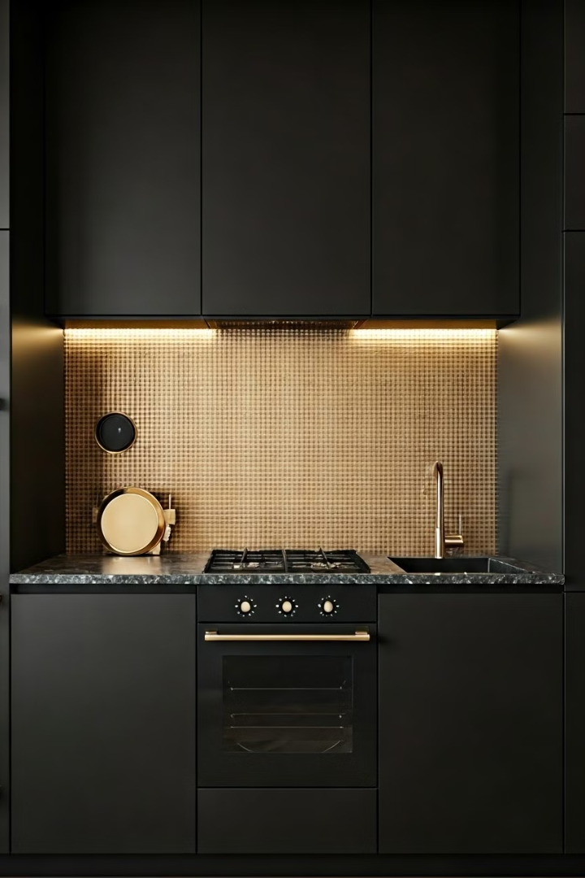
Home Automation and Control
Smart home devices can automate everyday tasks, such as turning off lights, adjusting temperature, and locking doors.
1
Smart Lighting
Control light intensity and color, set schedules, and create mood-enhancing lighting scenes.
2
Smart Thermostats
Optimize heating and cooling for energy efficiency and comfort.
3
Smart Appliances
Control appliances remotely, monitor their status, and receive notifications for maintenance.
4
Smart Security Systems
Secure your home with smart locks, cameras, and motion sensors.

Slide 6

Security and Monitoring
Smart home security systems enhance safety and peace of mind. They provide real-time monitoring, alerts, and remote access.
Smart Doorbells
Security Cameras
See who's at your door, even when you're not home.
Monitor your property from anywhere.
Motion Sensors
Detect movement and trigger alerts.

Slide 7
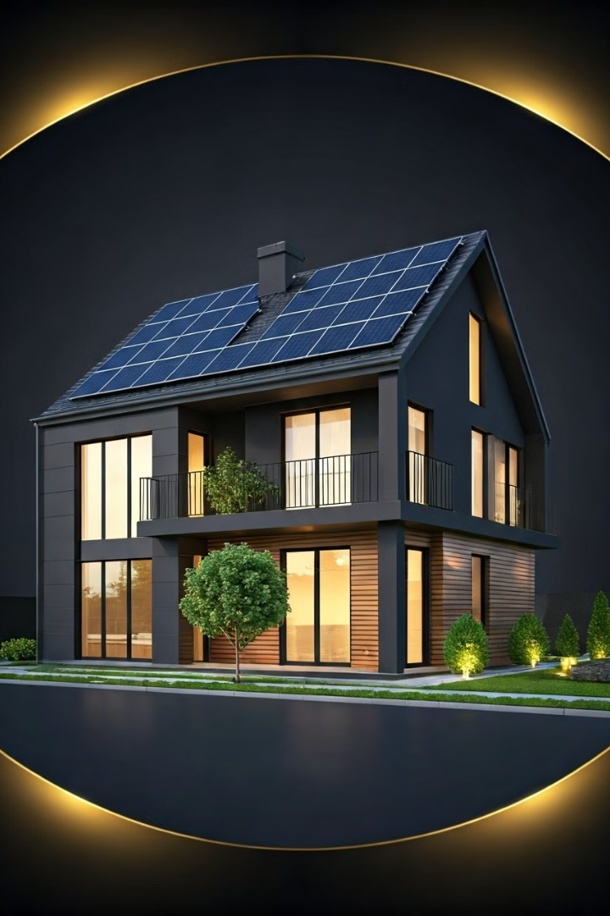



Energy Efficiency and Cost Savings
Smart home devices can optimize energy usage, leading to cost savings and a reduced environmental footprint.
Smart Thermostats
Learn your heating and cooling preferences, adjust temperatures automatically, and optimize energy consumption.
Smart Lighting
Automate lighting based on occupancy and daylight, reducing wasted energy.
Smart Appliances
Use energy-efficient modes, monitor consumption, and reduce standby energy usage.

Slide 8
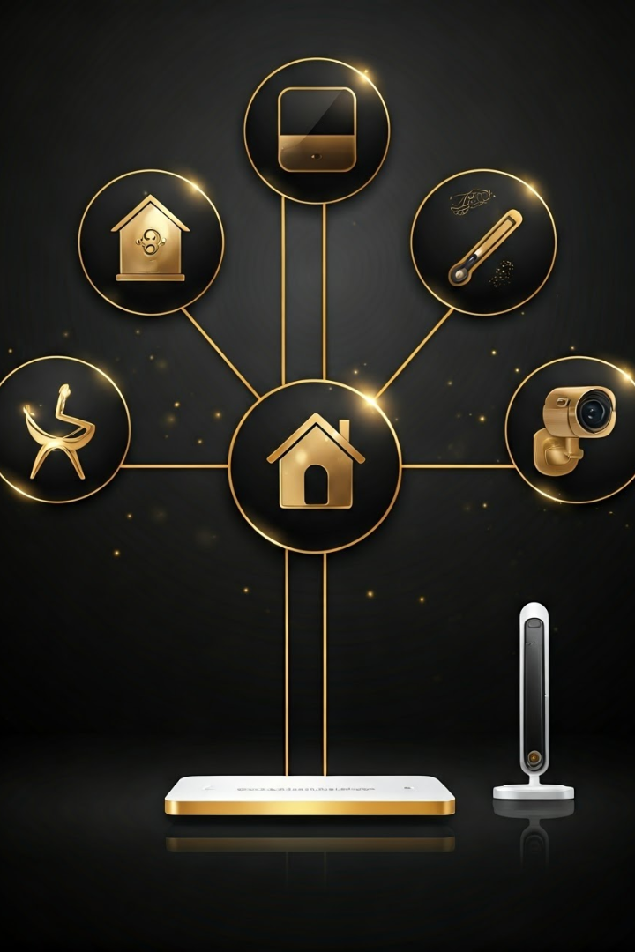
Compatibility and Interoperability
Ensure your smart home devices work together seamlessly by considering compatibility and interoperability.
Platform
Devices
Features
Amazon Alexa
Echo devices, smart lights, thermostats, appliances
Voice control, scheduling, automation
Google Assistant
Google Home devices, smart lights, thermostats, appliances
Voice control, scheduling, automation
Apple HomeKit
Apple devices, smart lights, thermostats, appliances
Voice control, scheduling, automation

Slide 9





Conclusion and Future Trends
Smart home technology is rapidly evolving. Expect advancements in AI, voice control, and seamless integration for a truly intuitive and personalized experience.
AI-Powered Personalization
Robotic Assistance
Predictive automation based on user preferences.
Intelligent robots performing household tasks.
Enhanced Voice Control
Seamless Interoperability
More natural and intuitive voice interactions.
All devices working together seamlessly.

Slide 10
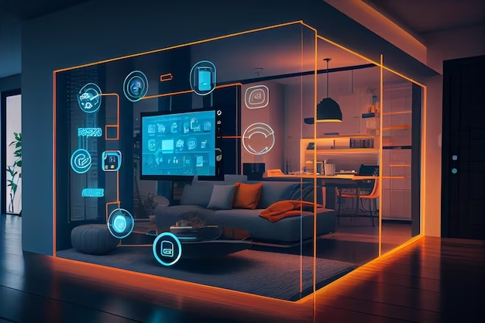
THANK
YOU

